Slide 1
Distributed Control and Automation Framework (DCAF)
Dynamic Modules
Benjamin Celis, Simon Perez

Slide 2
Agenda
Dynamic Module Introduction
Creating a Dynamic Module
Common Overrides
Table API
Project: Multiplexer Module

Slide 3
Exercises
Define the Module
Create the module configuration
To string from string
Test To string from string
Create the runtime
Test Runtime
Create UI
Optional (Import/export)

Slide 4
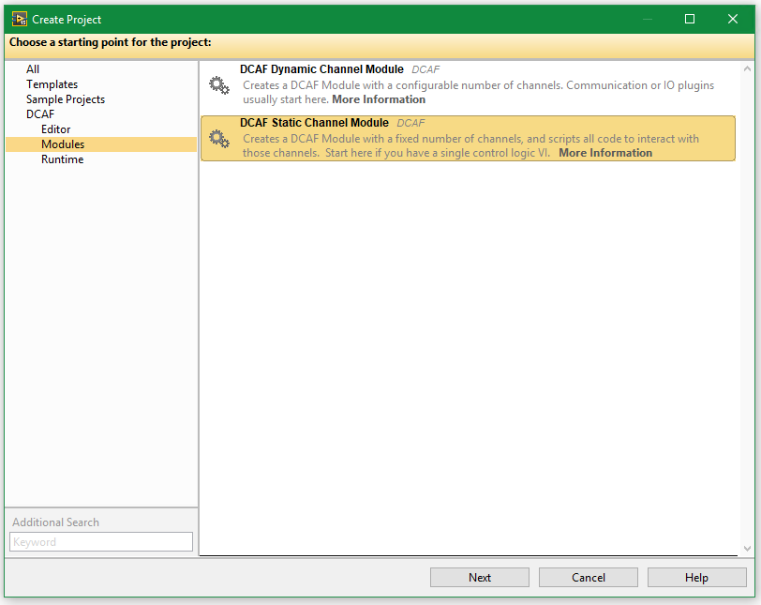
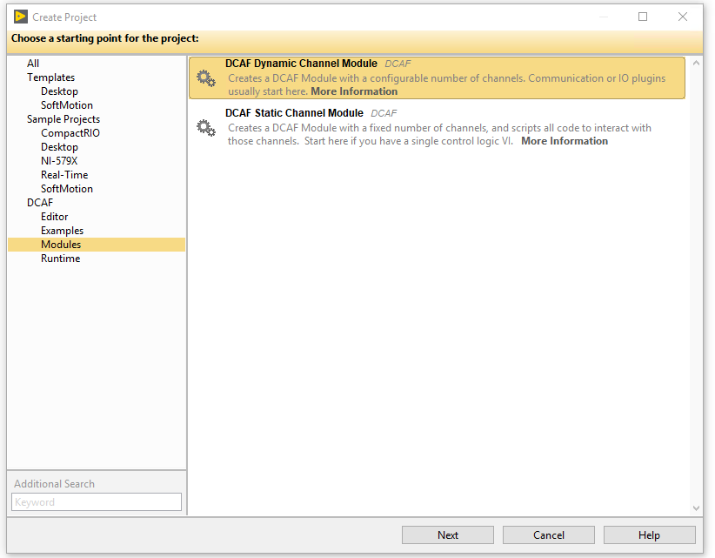
Static Or Dynamic?

Slide 5
Static or Dynamic
Static
Module developer defines the number of channels available in the module
Template includes UI ready to use.
Easier to Create
Mostly used for processing
Dynamic
Final user can configure the number of channels.
More flexible template
Requires more codding.
More cmmonly used for input/output

Slide 6
Multiplexer module description
Module will select between 2 channel which will be sent to the output.
The module most support multiple multiplexers
Input Channels will be doubles, output will be double and select a Boolean.
There is a scaling multiplier that affect all modules, and multiply the output. This is defined in the configuration and has a default value of 1.

Slide 7
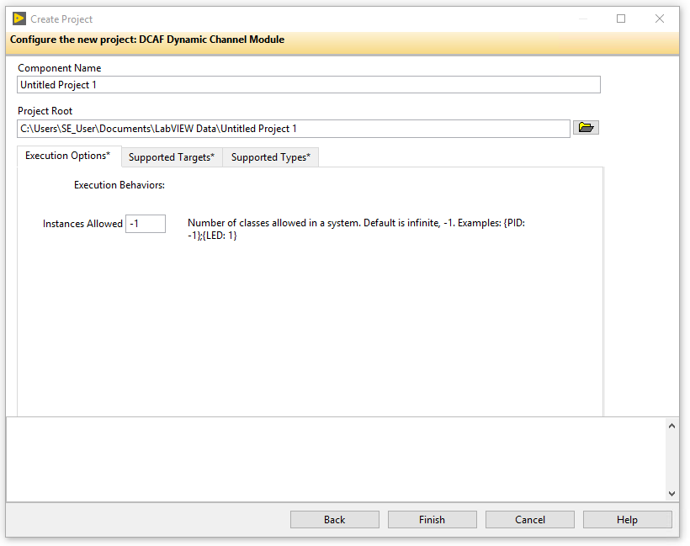
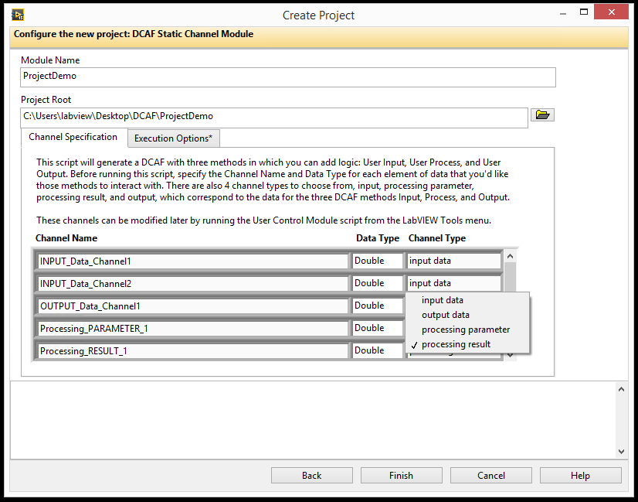
Creating a Dynamic Module
Create Project through Template
Creates 3 main classes:
ModuleName configuration.lvlclass
ModuleName editor.lvlclass
ModuleName runtime.lvlclass

Slide 8
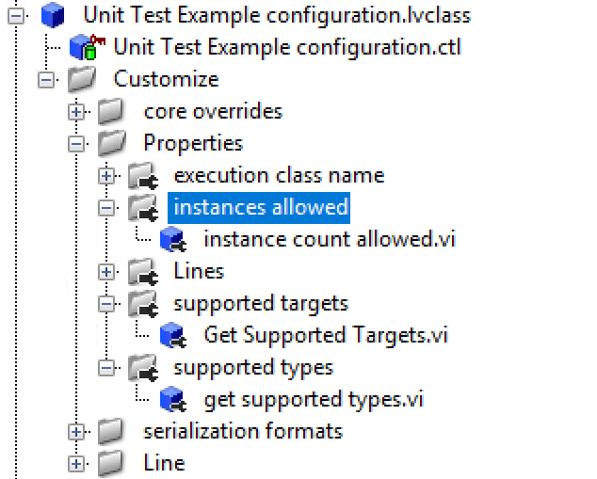
Config Options
Supported Targets
Supported Types
Execution Options

Slide 9
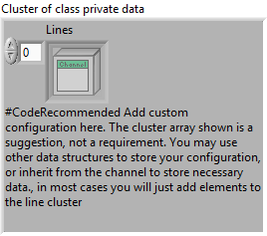
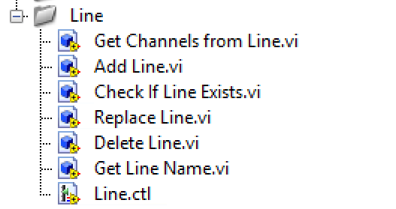
Configuration Class
Lines
A Line in DCAF is a logical grouping of one or more channels and their data or name; an instance of 1 of whatever the module “does”.
Modules will have multiple lines
There are pre-existing VIs that operate on lines.
Additional Configuration
All the additional configuration in the module that apply to all lines.

Slide 10
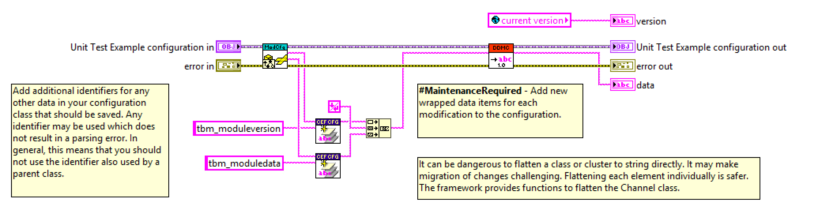
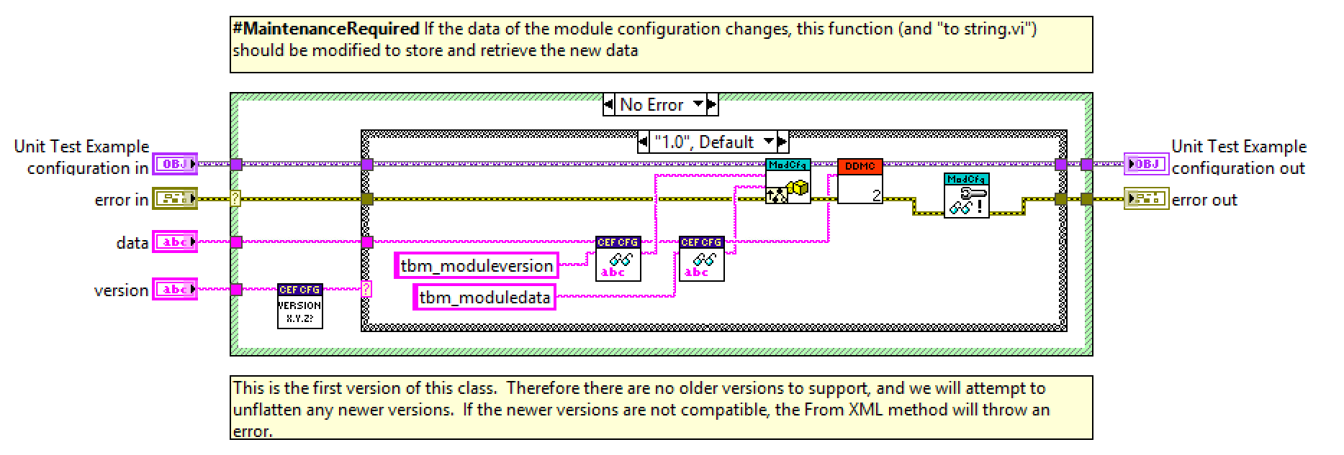
To String from String

Slide 11
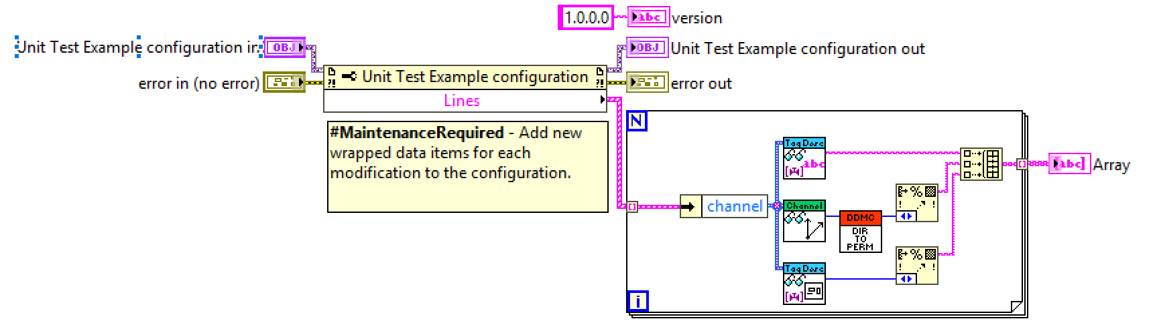
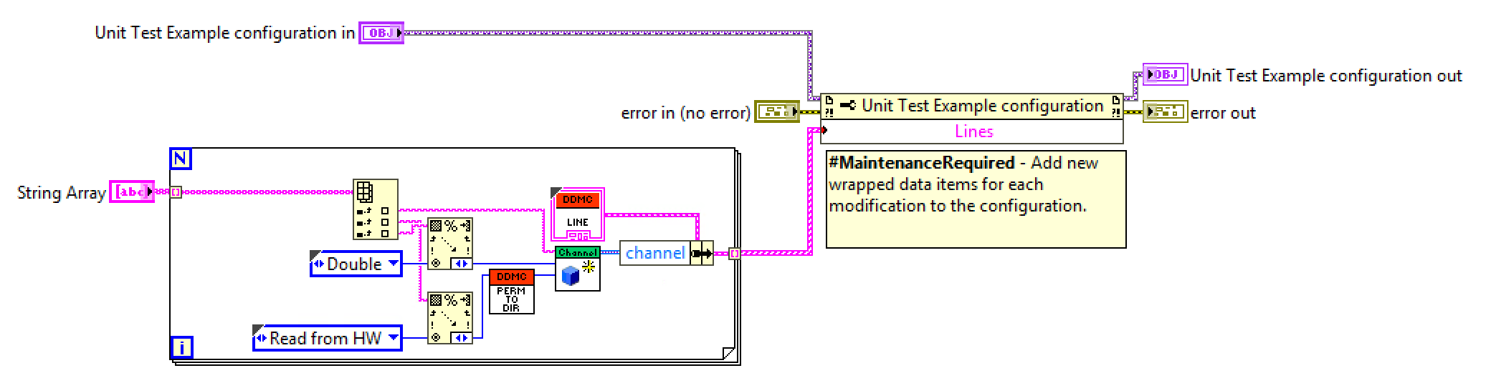
From String Array to String Array

Slide 12
Exercise 1: Multiplexer configiration

Slide 13
Exercise 1
Create the multiplexer module:
Allow multiple instances
Can run on any target
Supports only doubles and Booleans
Override Get Line Name
Update Get channels from line
Implement to String and from String
Update the Create test configuration VI
Update the to string and from String Unit test
Implement the From String Array to String Array
Update the to String and from String Unit test

Slide 14
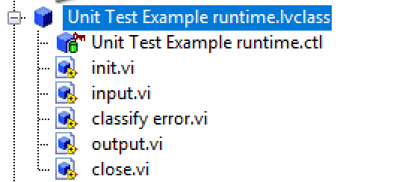
Runtime

Slide 15
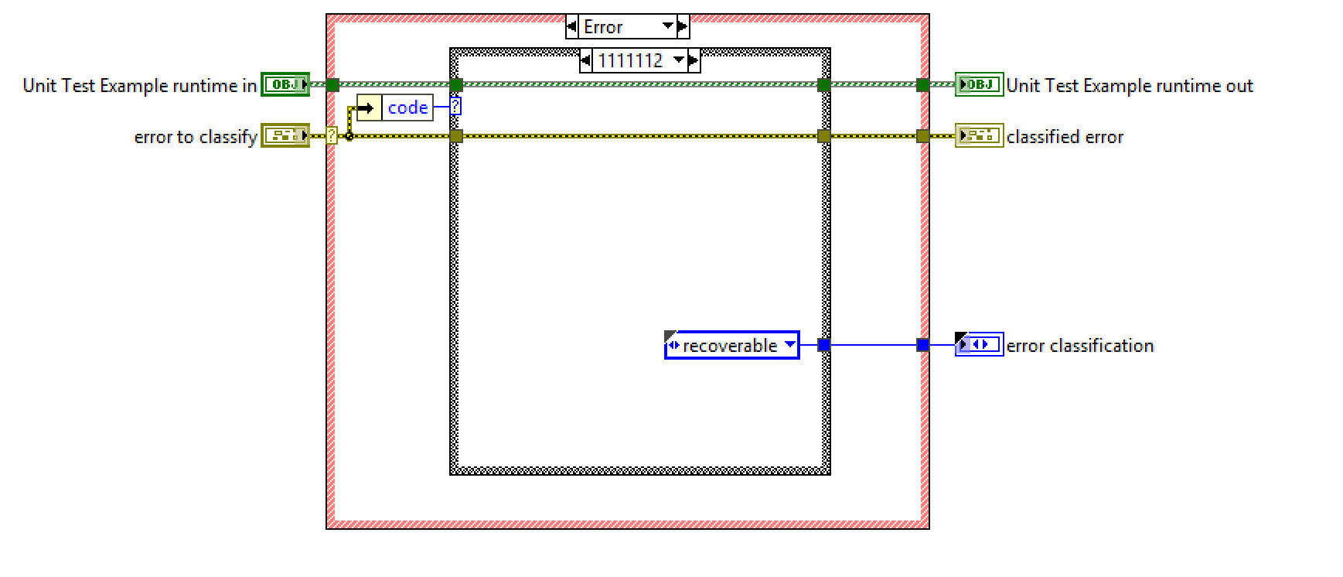
Classify Error

Slide 16
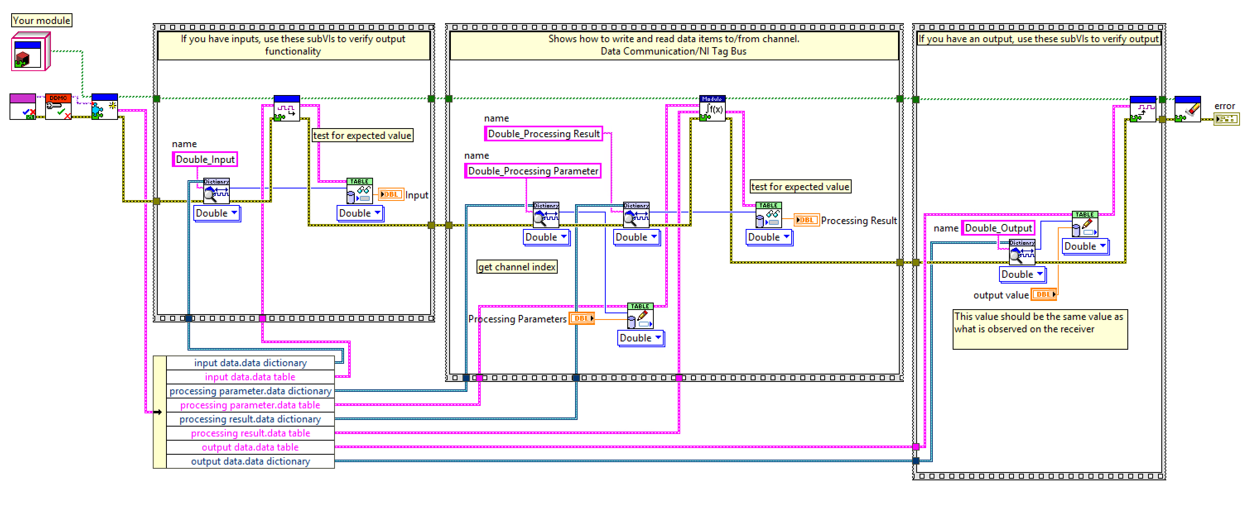
Test Runtime

Slide 17
Init and mapping

Slide 18
Runtime Example

Slide 19
Exercise 2: Multiplexer Runtime

Slide 20
Exercise 2: Multiplexer Runtime
Initialize the runtime class with the scaling value
Write the runtime to multiplex channels
Unit test the runtime.

Slide 21
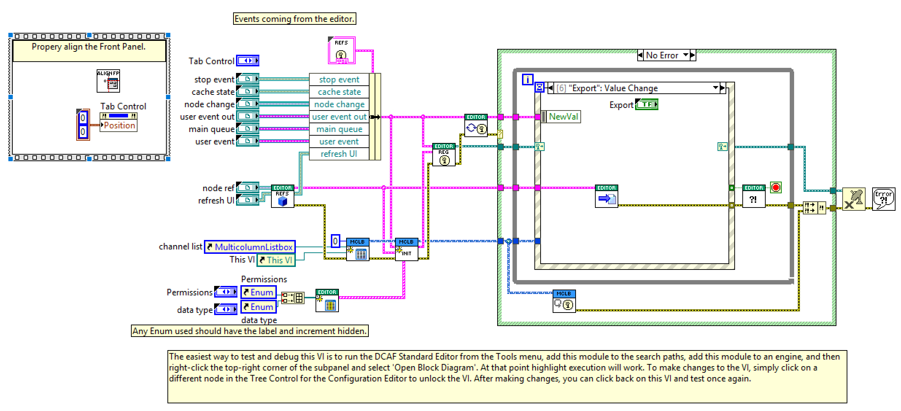
Editor Node

Slide 22
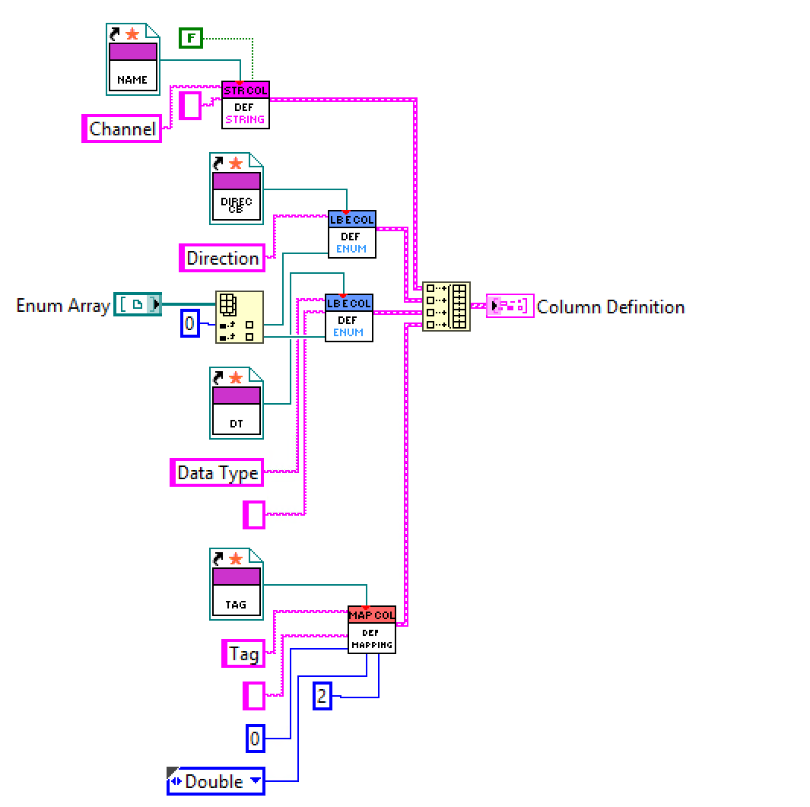
Define Columns

Slide 23
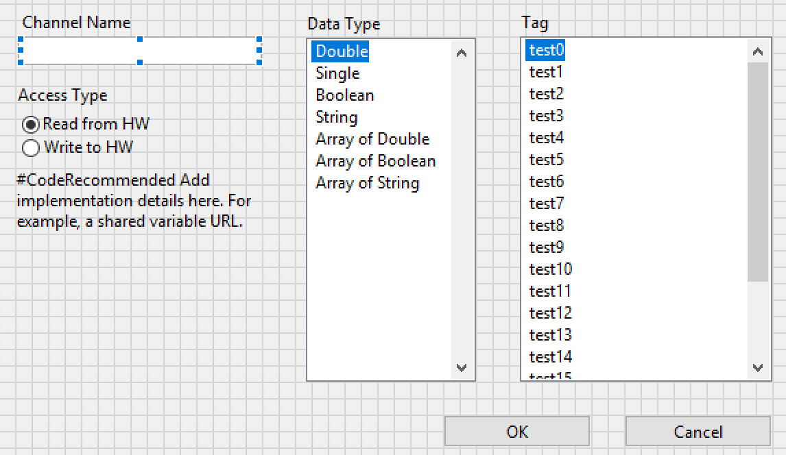
Line Configuration Dialog

Slide 24
Exercise 3: Editor Node

Slide 25
Exercise 3: Editor Node
Define Columns
Callbacks
To Table
Line Configuration Dialog.

Slide 26
Exercise 4: Run your module in the engine

Slide 27
Exercise 4: Running with the module
Use the UI module to test 2 multiplexers in the runtime

Slide 28
Conclusions
Static Modules have their channels and parameters defined by end user
Create the Module from the Dynamic Module Template
Create the configuration and define Line
Implement the runtime
Create the UI
You should do testing and validation of your module

